Slide 1
Video and Movie Recommendation Engine using MMoE
Presented by:
Gulnara Timokhina,
Mirsaeid Abolghasemi
Poornapragna Vadiraj
Varun Bhaseen

Slide 2
Introduction
Recommendation Engine

Slide 3
Purpose and Objective
Purpose
The primary purpose of this project is to create a recommendation engine using MMoE (Multi gate Mixture of Experts) for a recommendation.
Create a web application
Objectives
Create a web application for recommending Videos
Colab to train the MMoE model to give scores for ranking
Using TFX as ML pipeline

Slide 4
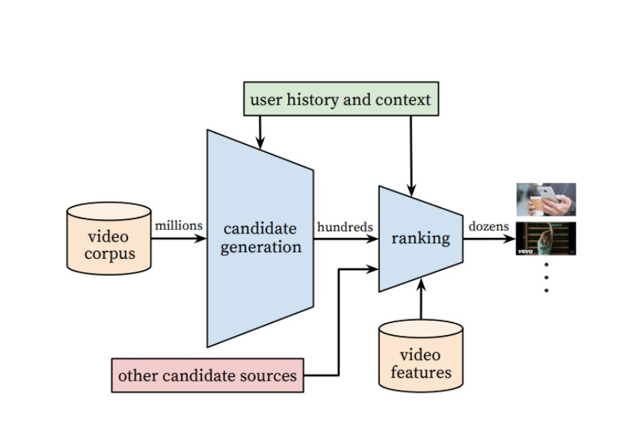
Recommendation System Architecture
Single Task Recommendation System

Slide 5
Challenges in Recommendation System
There are often different and sometimes conflicting objectives which we want to optimize for. For example, we may want to recommend videos that users rate highly and share with their friends, in addition to watching
There is often implicit bias in the system. For example, a user might have clicked and watched a video simply because it was being ranked high, not because it was the one that the user liked the most. Therefore, models trained using data generated from the current system will be biased, causing a feedback loop
Another main challenge of recommendation systems is scalability.

Slide 6
Multi Gate Mixture of Experts
MMoE based ranking system

Slide 7
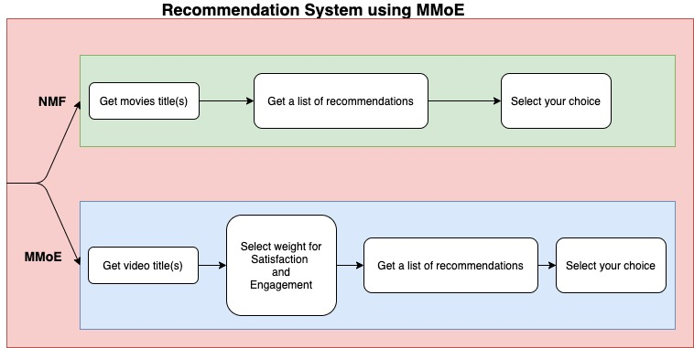
Recommendation System Web app Architecture
We are using NMF for getting ranking a list of movies from candidate lists
MMoE is used to rank the videos from Youtube dataset based on queries given by user

Slide 8
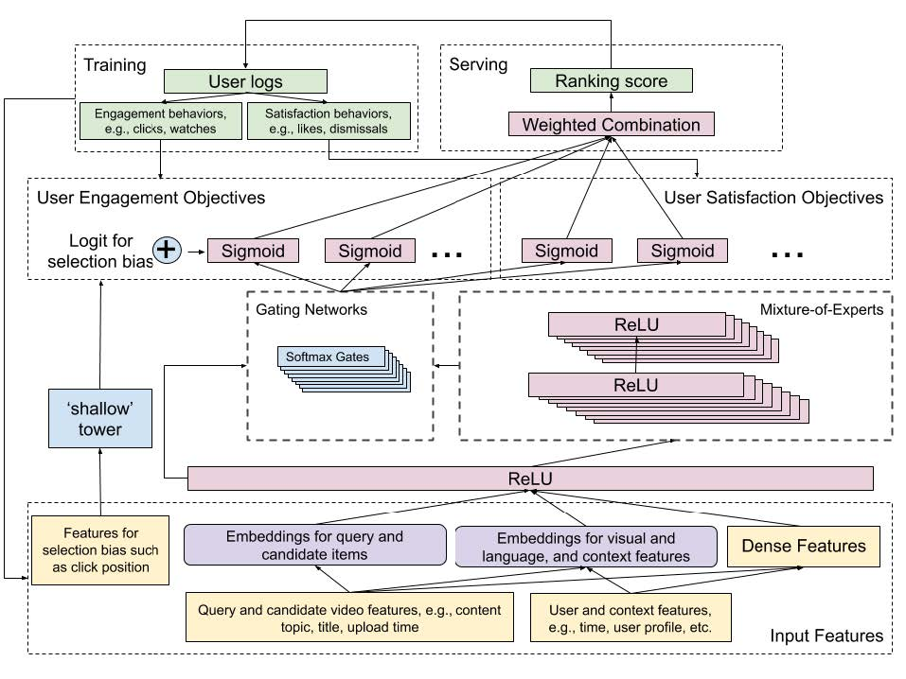
MMoE Architecture
Shallow Tower, can separate the learning of user utility and position bias.
It is removing the selection bias, takes input related to the selection bias, e.g., ranking order decided by the current system, and outputs a scalar serving as a bias term to the final prediction of the main model.
The Shallow tower factorizes the label in training data in two parts: the unbiased user utility learned from the main model, and the estimated propensity score learned from the shallow tower.

Slide 9
Recommendation Engine
Candidate List
Ranking Generation
Potential candidates using Cosine Similarity
Content Based
Query Entered from user
Using MMoE to support two objectives
Satisfaction Score
Engagement Score
Notes:
We approach the above challenges using the Multi gate mixture of experts. it introduces a shallow tower to model and remove selection bias. The system can handle multiple queries at once
Our recommendation Engine contains two stages:
Candidate Generation
Ranking: Two objectives
Satisfaction Score : satisfaction objectives, such as user liking a video on YouTube, and leaving a rating on the recommendation
Ranking Score: engagement objectives, such as user clicks, and degree of engagement with recommended videos

Slide 10
Candidate List
Using Cosine Similarity to generate candidate list
At the candidate generation stage, we retrieve a few hundred candidates from a huge corpus. Our ranking system provides a score for each candidate and generates the final ranked list.
At the end, all candidates are pooled into a set and subsequently scored by the ranking system.

Slide 11
Colab Demo

Slide 12
Application Demo
Model Deployment
Web Application
Challenge: Bad Data
Challenge: Cold Start
WEB APPLICATION DEMO

Slide 13
TFX Pipelines
ExampleGen ingests and splits the input dataset.
StatisticsGen calculates statistics for the dataset.
SchemaGen examines the statistics and creates a data schema.
ExampleValidator looks for anomalies and missing values in the dataset.
Transform performs feature engineering on the dataset.
Trainer trains the model using TensorFlow Estimators or Keras.
Evaluator performs deep analysis of the training results.
InfraValidator checks the model is actually servable from the infrastructure, and prevents bad model from being pushed.
Pusher deploys the model to a serving infrastructure.
BulkInferrer batch inference on the model with unlabelled examples.
TensorFlow Serving for serving.

Slide 14
ML Operations
Trello Board for Project Management
Google Drive for Content Sharing
Zoom for Meeting

Slide 15
Thank you
Questions?

Slide 16
References
https://dl.acm.org/doi/10.1145/3298689.3346997
https://medium.com/@bhatia.suneet/a-multitask-ranking-system-how-youtube-recommends-the-next-videos-a23a63476073
https://daiwk.github.io/assets/youtube-multitask.pdf
Dataset: https://www.kaggle.com/datasnaek/youtube-new

